Slide 1

Cybersecurity: Suspicious Web Threat Interactions
• Name: Vadla Rajashekar Chary
• Domain: Data Analyst / Cybersecurity
• Tools: Python, Machine learning, python, SQL, Excel, Google Colab

Slide 2
Problem Statement
Modern web servers face increasing cyber threats.
Manual detection is inefficient.
Need an automated system to identify suspicious web traffic.

Slide 3
Project Objective
Analyze web traffic data
Detect suspicious interactions
Apply machine learning models
Visualize attack patterns

Slide 4
Dataset Overview
Source: AWS CloudWatch Logs
Records: Web traffic interactions
Features:
- Bytes In / Bytes Out
- IP Addresses
- Country Code
- Protocol
- Detection Type

Slide 5
Tools & Technologies
Google Colab
Python
Pandas & NumPy
Matplotlib & Seaborn
Scikit-learn

Slide 6
Data Preprocessing
• Removed duplicates
• Converted timestamps
• Standardized country codes
• Created new features

Slide 7
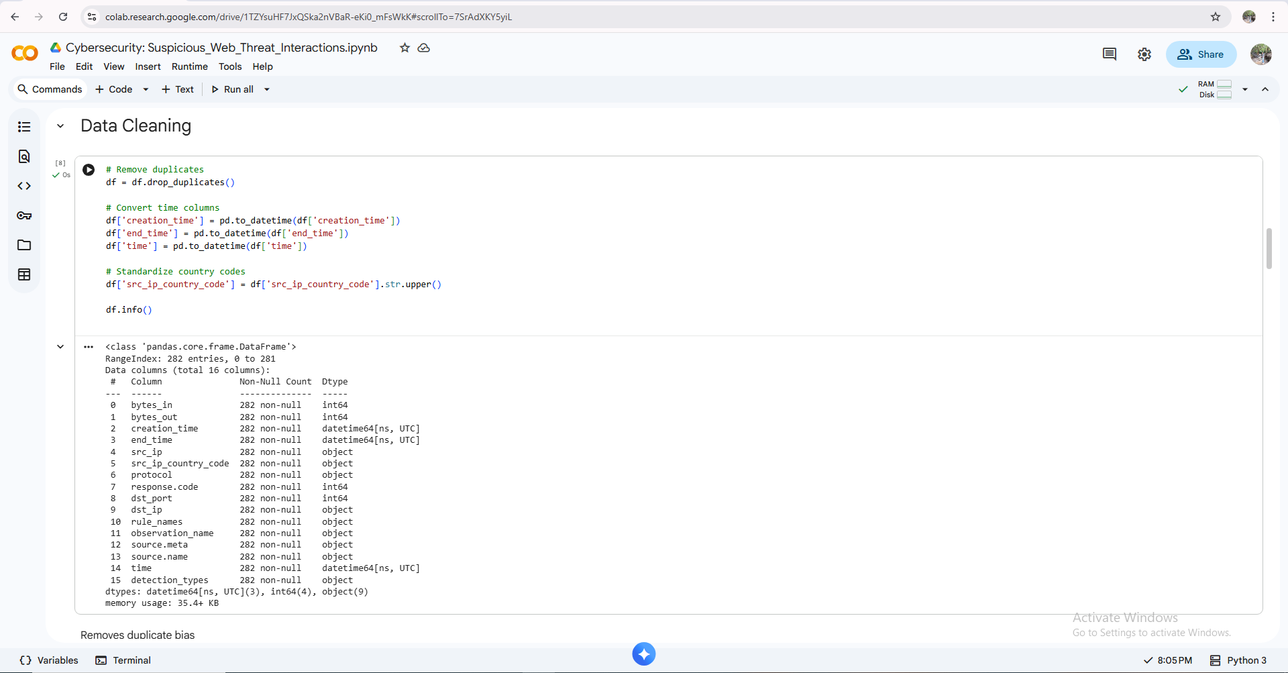
Data Cleaning

Slide 8
Feature Engineering
• Session Duration
• Average Packet Size
• Scaled numerical features
• Encoded categorical variables

Slide 9
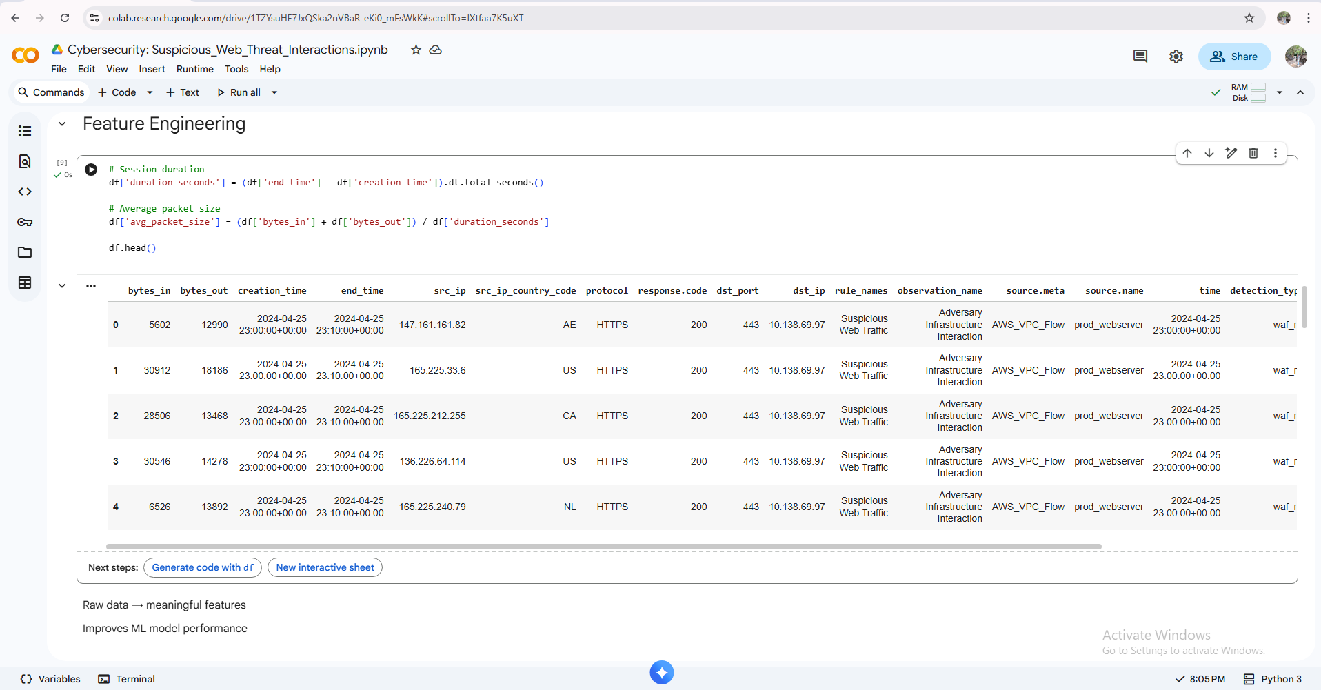
Feature Engineering

Slide 10
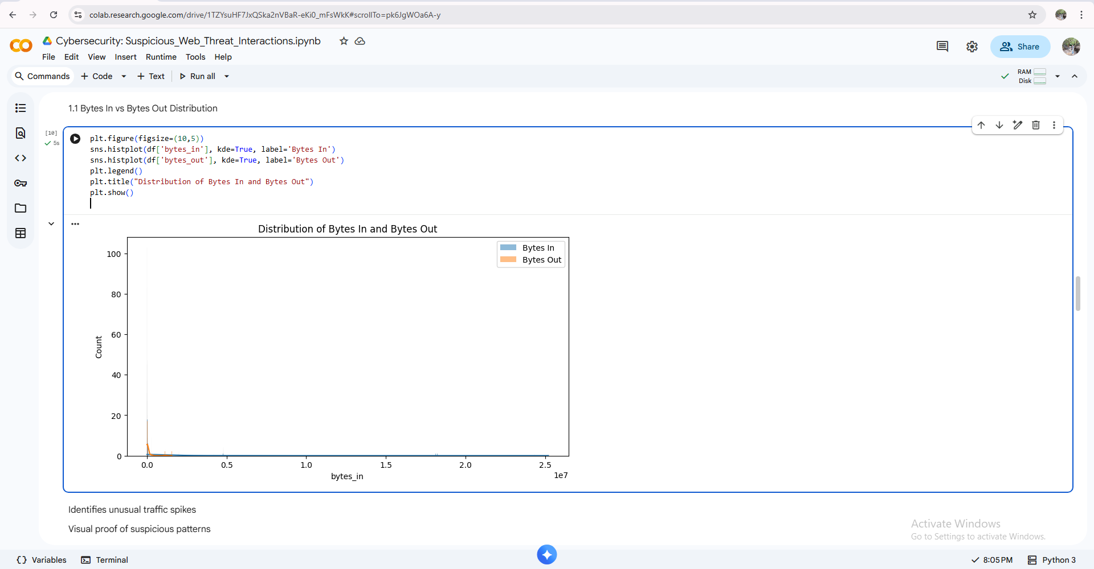
Exploratory Data Analysis (EDA)
1.1 Bytes In vs Bytes Out Distribution

Slide 11
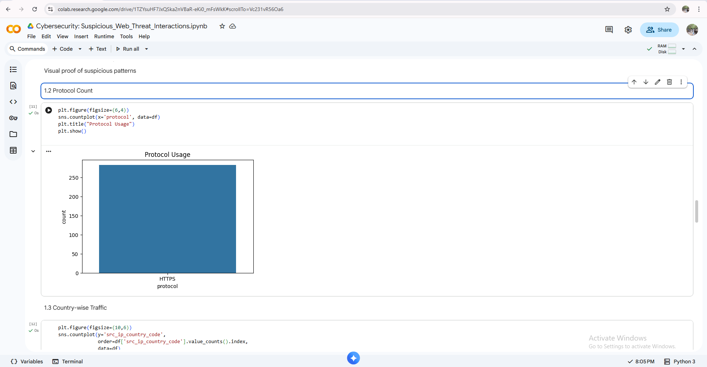
1.2 Protocol Count

Slide 12
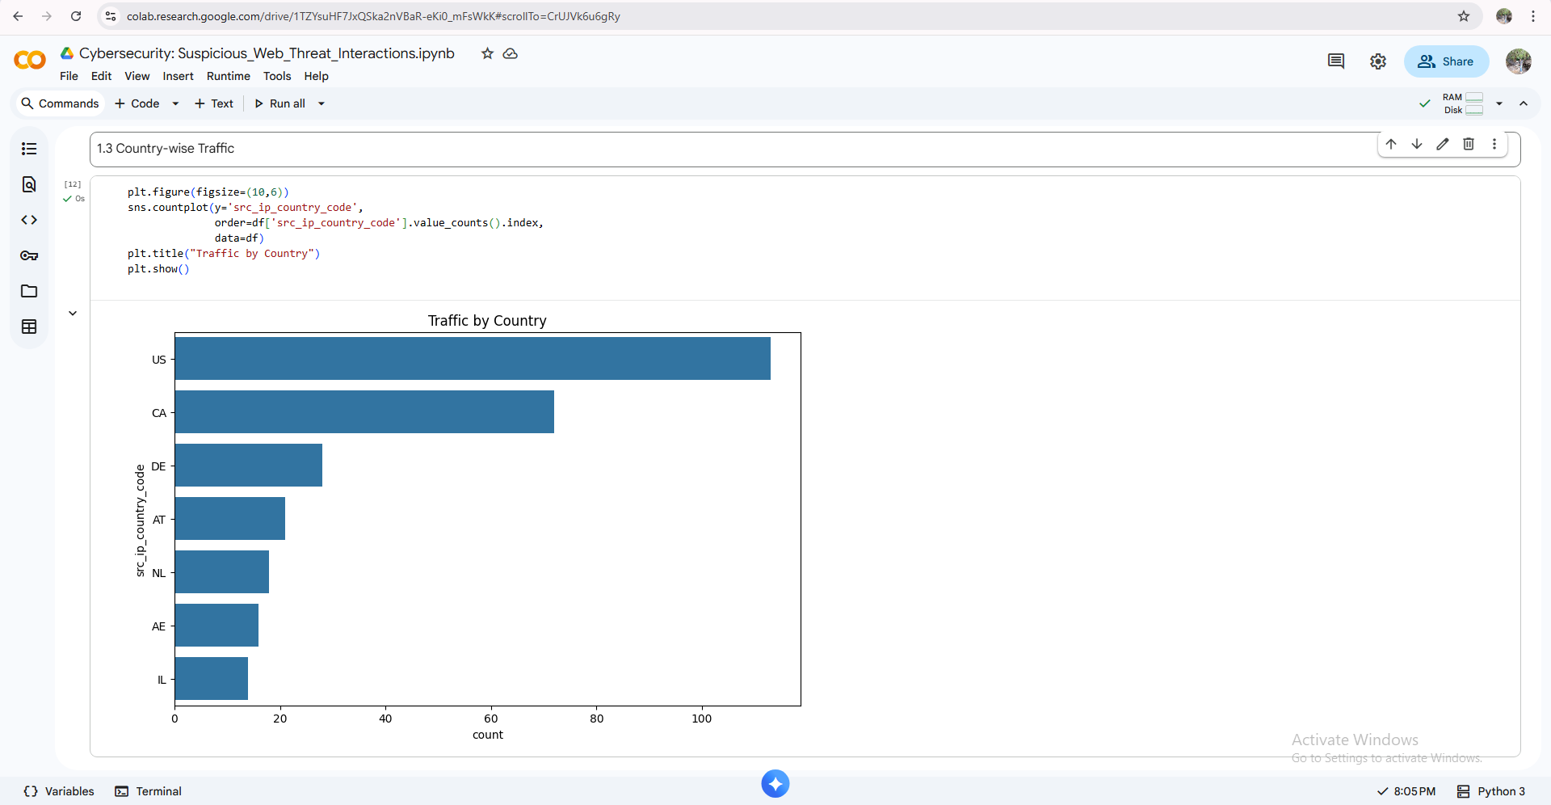
1.3 Country-wise Traffic

Slide 13
Machine Learning Model
• Model Used: Random Forest Classifier
• Why Random Forest?
• Handles non-linear data
• Robust to noise
• High accuracy

Slide 14
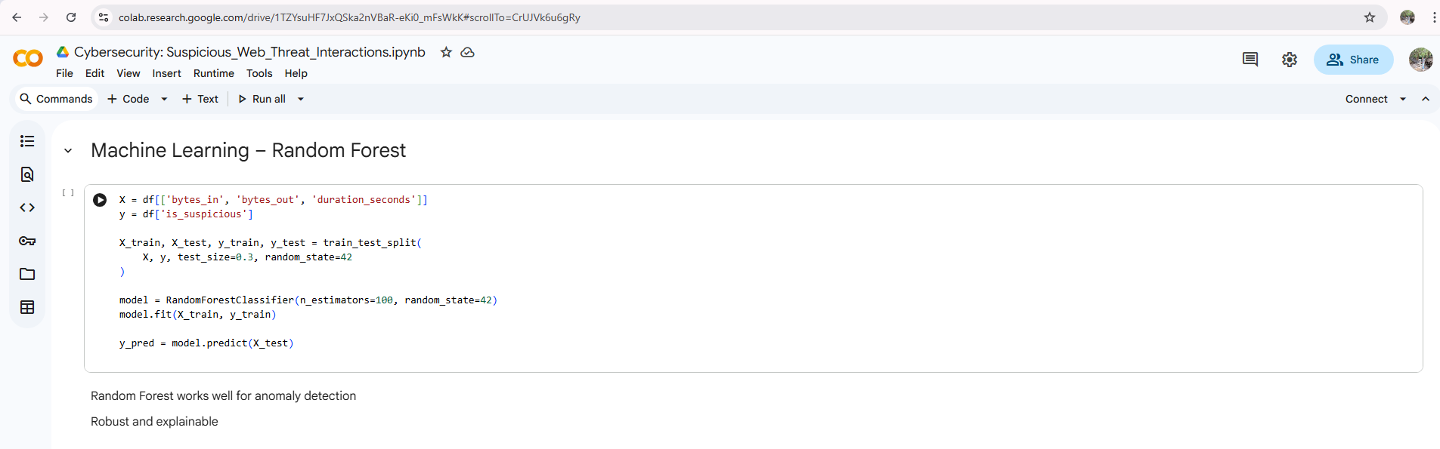
Machine Learning – Random Forest

Slide 15
Model Evaluation
• Accuracy: 100%
• Precision: High
• Recall: High
• Reliable threat detection

Slide 16
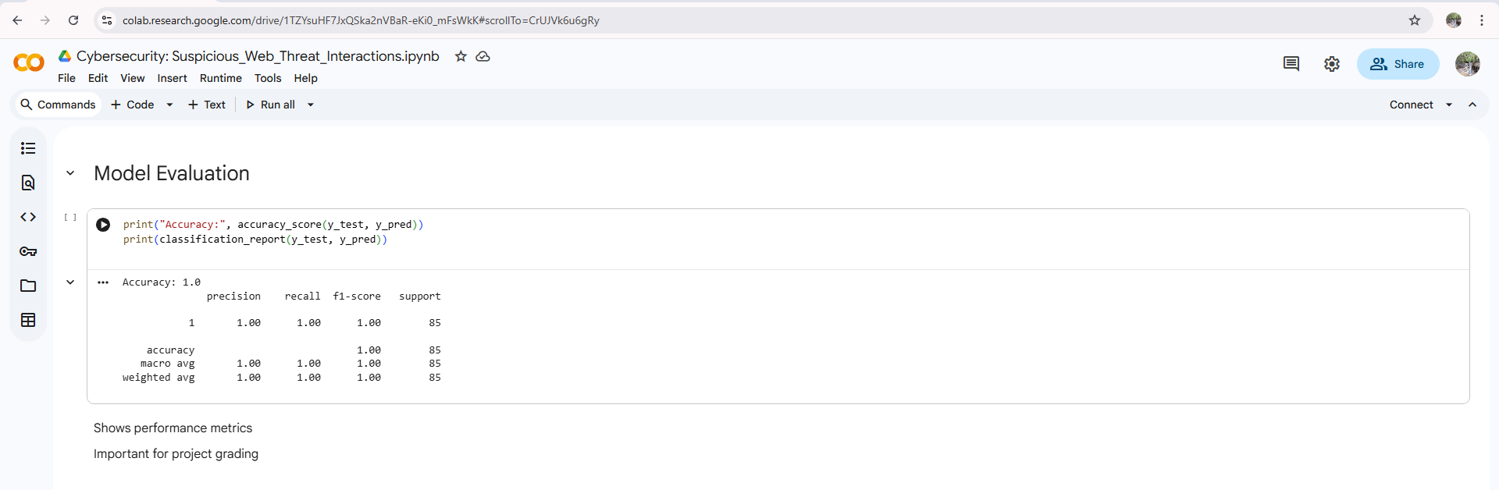
Model Evaluation

Slide 17
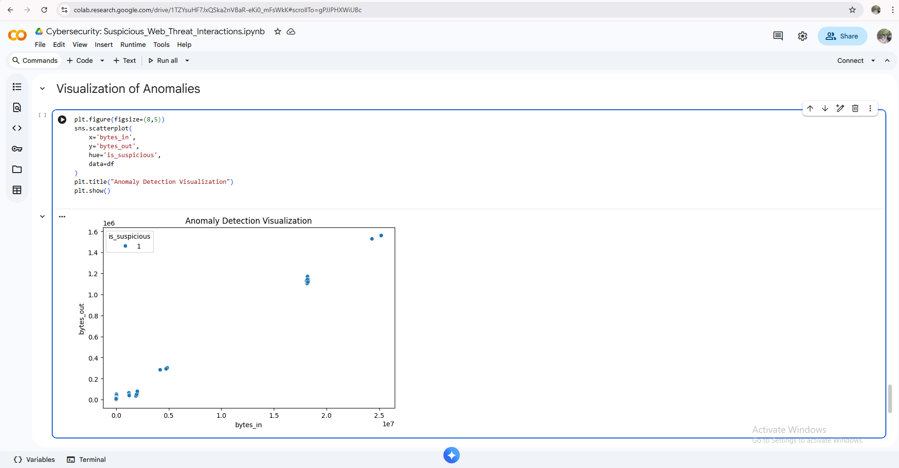
Visualization of Anomalies

Slide 18
Key Findings
• High incoming traffic indicates attacks
• Repeated suspicious access from certain countries
• Non-standard patterns detected effectively

Slide 19
Conclusion
• Successfully built an automated threat detection system
• Machine learning improves cybersecurity monitoring
• Can be extended to real-time systems

Slide 20
Future Scope
• Successfully built an automated threat detection system
• Machine learning improves cybersecurity monitoring
• Can be extended to real-time systems

Slide 21
Thank You

